Slide 1

Developing Organizational Resilience Culture
Embedding resilience into identity, not policy
Culture as lived behavior, not merely stated policy.
Trust as the essential foundation for resilience maturity.
Leadership modeling that actively shapes positive organizational tone.
Moving from basic awareness to deeply embedded identity.
Empowering employees to act and make informed decisions.
Fostering continuous learning and adaptation for growth.

Slide 2
CLASS AGENDA
CLASS OBJECTIVES
Defining adaptive resilience culture
Culture drives proactive behavior
Trust enables deep resilience
Habits vs. compliance
Leadership reinforces culture
Measuring resilience impact
Fostering learning & adaptation
Culture as lived system
Behavior precedes procedure
Align through shared meaning
Strengthen trust for resilience
From awareness to identity
Empower adaptive responses
Shared responsibility for safety

Slide 3

What Resilience Culture Actually Is
Culture is how people behave when pressure hits unexpectedly.
It shows up before documentation is even referenced.
Resilience becomes instinctive when truly normalized within.
Cultural readiness deeply precedes operational readiness.
It's built through continuous learning and adaptation.
Shared values drive consistent adaptive actions.

Slide 4

Why Culture Matters More Than Planning
Plans fail when culture cannot sustain consistent execution
Trust determines speed and agility before policy does
Behavior decides alignment and cohesion under uncertainty
Culture sets posture and mindset long before activation
Shared values empower rapid, effective decision-making
Adaptability stems from cultural flexibility, not rigid rules

Slide 5

Cultural Foundation: Belief and Mindset Layer
Resilience begins as shared belief, not rigid process documentation.
People support what they feel deeply connected to.
Meaning anchors behavior more than explicit instruction.
Mindset forms before strict discipline shows up.
Shared values inherently drive collective purpose.
Trust fundamentally empowers autonomous decision-making.

Slide 6
PIVOT #1 – Awareness Reflection
Culture begins with widely shared awareness.
People model what they truly internalize.
Understanding grants informed participation.
Awareness precedes lasting commitment.
Meaning fuels voluntary adoption, not compliance.
Open dialogue encourages participation
Blind spots weaken cultural formation.
Shared language fosters collective readiness.
People align when authentically included.
Context creates genuine belonging before action.
Awareness is the formative seed of identity.
Unaddressed assumptions hinder progress.

Slide 7

Leadership Modeling and Tone
Culture follows what leaders consistently normalize through action.
Modeling signals what the organization truly values most.
Tone creates psychological safety before rigid structure.
Behavior legitimizes expectation more than mere policy.
Leaders embody the desired future state.
Their presence validates and empowers teams.

Slide 8
PIVOT #2 – Ownership Reflection
Ownership is cultural, not procedural.
People emulate observed behavior.
Leadership defines psychological tone.
Trust grows through consistency.
Modeling reinforces powerfully.
Authentic engagement builds commitment.
Shared purpose drives collective ownership.
Culture erodes with symbolic leadership.
Integrity maintains credibility under stress.
Influence follows genuine team alignment.
Belief is earned through consistent visibility.
Ownership is culture's steadfast anchor.
Accountability fosters responsibility.
Transparency builds trust

Slide 9

Behavioral Signals that Define Culture
Culture lives in daily, subtle micro-behaviors
The smallest acts reveal true organizational norms
People read consistent conduct more than policy
Behavior is culture's most visible layer
Every interaction shapes shared understanding
Informal leaders embody core values

Slide 10
PIVOT #3 – Norms & Behavior Reflection
Habits reveal cultural reality quickly and profoundly
Misalignment breaks credibility instantly and completely
Norms form through repetition, not mandate or decree
People copy what feels psychologically safe and rewarded
Words collapse when conduct contradicts and frustrates
Behavior confirms belonging inside culture and community
Culture spreads faster than enforcement or directives
People trust behavior over messaging and promises
Consistency turns value into practice through actions
Norms emerge from observed truth and actions
Unspoken rules often guide daily decisions
Authenticity builds trust and true adherence

Slide 11

Reinforcement Through Alignment and Repetition
Culture stabilizes when reinforced through consistent action continuously.
Repetition turns shared belief into enduring muscle memory.
Alignment becomes an ingrained living organizational standard.
Reinforcement converts collective learning into shared instinct.
Consistent leadership modeling strengthens cultural adherence.
Feedback loops solidify desired behaviors rapidly.

Slide 12
PIVOT #4 – Reinforcement Reflection
Reinforcement powerfully protects culture from erosion.
Without continuous reinforcement, norms quickly dissolve.
What is consistently repeated becomes culturally "real."
Culture subtly drifts when left unattended.
Alignment firmly holds when reinforced visibly.
Renewal actively keeps belief psychologically active.
Repetition truly signals commitment over time.
Accountability deeply sustains identity formation.
Consistency reliably builds collective trust.
Repetition effectively becomes the stabilizer.
Continuous reinforcement drives positive habits.
Inaction inevitably leads to cultural decay.
Shared understanding strengthens collective identity.
Neglecting core values causes fragmentation.

Slide 13

Institutionalizing Resilience
Culture matures when resilience becomes our identity.
People stop "doing resilience" and start "being resilient" naturally.
Identity creates permanence beyond leadership and staff changes.
Culture becomes self-sustaining at maturity, weathering any storm.
Continuity is assured through ingrained practices.
Adaptability becomes an inherent organizational strength.

Slide 14
PIVOT #5 – Cultural Identity Synthesis
Culture succeeds when resilience feels natural and organic.
Culture feels lived, not taught, deeply ingrained.
Identity protects continuity instinctively, guiding decisions.
Identity creates continuity without constant reminders or oversight.
Resilience becomes shared character, a core trait.
Belief outlives documentation and messaging, truly embedded.
Alignment becomes automatic posture, effortless coordination.
People act aligned before instruction arrives, spontaneously contributing.
The organization "becomes" its readiness, truly prepared.
Ownership becomes internalized behavior, driving excellence forward.
Innovation emerges from collective wisdom.
Adaptability is the new normal.
Proactive adaptation defines organizational spirit.
Shared purpose fuels collective endeavor.

Slide 15

What Cultural Maturity Looks Like
Trust remains stable, enabling rapid adaptation, even when conditions shift.
People orient before reacting thoughtfully, proactively, under pressure.
Alignment replaces compliance-driven behavior with shared purpose.
Resilience becomes culturally assumed, a core strength.
Values are deeply embedded, guiding everyday decisions.
Continuous learning fosters growth and innovation.

Slide 16

How Cultural Failure Shows Up
People retreat into defensive, isolated silos when stress rises.
Messaging feels performative, lacking genuine credibility.
Trust collapses unexpectedly faster than processes respond.
Fear overrides organizational alignment instantly.
Blame culture flourishes, hindering accountability.
Initiative dwindles, impacting overall productivity.

Slide 17

Rebuilding Trust and Consistency
Trust is restored through consistent presence, not empty promise.
People re-engage once genuine safety is modeled.
Repair requires authentic, lived transparency.
Consistency recreates organizational legitimacy.
Accountability fosters deep commitment.
Open communication bridges divides.

Slide 18

The Role of Leadership Presence
Culture watches behavior closely before communication becomes effective.
Presence reduces uncertainty and provides clear guidance without instruction.
Tone carries significant psychological weight and impact.
Model precedes message always in establishing credibility.
Consistency reinforces leadership's message.
Empathy strengthens team cohesion.

Slide 19

The Role of Peer Reinforcement
Culture stabilizes when peers uphold norms through consistent actions.
Reinforcement diffuses beyond leadership circles, reaching everyone.
Teams become credibility carriers for shared values.
Culture spreads through participation and mutual support.
Peer feedback fosters continuous positive growth.

Slide 20

Culture Under Real Crisis Stress
Crisis does not create culture, it exposes its true strengths.
Instability reveals whether trust is truly durable or superficial.
Orientation holds only when identity is deeply internal and shared.
Culture becomes the nervous system under immense stress and pressure.
Shared values guide collective action effectively.
Adaptability thrives when resilience is built-in.

Slide 21
SUMMARY & TAKEAWAYS
Culture is resilience lived, actively demonstrated, not stated.
Trust is the outcome of alignment, consistent actions, not messaging.
Leadership models tone before teams fully embrace and internalize it.
Behavioral norms reveal maturity and strength before process does.
Reinforcement prevents cultural erosion and strengthens bonds over time.
Institutionalization turns resilience into core organizational identity and practice.
Real resilience is who the organization truly becomes, deeply embedded.
Continuous learning fosters adaptability and sustained resilience.
A shared purpose unifies efforts during times of adversity.

Slide 22
BREAK TIME
Be back in 15 mins.
Notes:
https://www.ncsc.gov.uk/static-assets/documents/PwnedPasswordsTop100k.txt

Slide 23
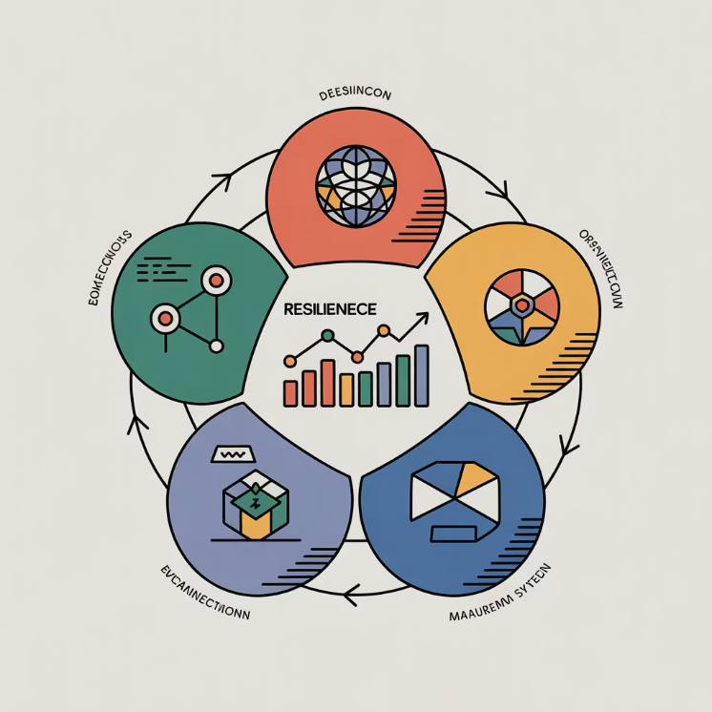
Resilience Maturity Models
Assessing capability strength across core dimensions
Framework for evaluating organizational resilience readiness
Dimension-based assessment methodology across five key areas
Evidence-based capability measurement beyond documentation
Practical guidance for building sustainable resilience maturity

Slide 24
CLASS AGENDA
CLASS OBJECTIVES
What maturity really represents
Why capability > documentation
Five core maturity dimensions
How to interpret improvement
Linking maturity to resilience outcomes
Learn how maturity is evaluated structurally
Distinguish policy from proven capability
Understand dimension-based scaling
Identify where gaps actually originate
Prepare for real-world maturity assessment

Slide 25

What Maturity Really Means
Maturity is the consistency of capability under pressure
It reflects how reliably resilience holds when tested
Strength is proven through execution, not artifacts
Maturity is evidence of readiness, not intention
It emphasizes practical application over theoretical knowledge or mere compliance.
A high maturity level indicates consistent performance even in unforeseen circumstances.

Slide 26

Why Maturity Is Not Documentation Volume
Policy can exist without usable capability
Control lists do not guarantee performance
Culture carries resilience more than written plans
Real maturity is visible in behavior, not binders
Compliance checkboxes don't build operational strength
The volume of written procedures often outweighs their practical application

Slide 27

Governance Dimension
Governance defines who owns decisions during uncertainty
Escalation confidence shows governance maturity instantly
Legitimacy must exist before speed matters
Clear accountability prevents conflict under stress
Defined roles and responsibilities streamline operations
Transparent processes build trust and facilitate compliance

Slide 28
PIVOT #1 – Governance Reflection
Ownership must be explicit to be trusted
Hesitation reveals weak governance
Ambiguity breaks governance during pressure
Structure reduces interpretive conflict
Authority is psychological before procedural
Clarity becomes operational trust
Decision confidence signals real maturity
Escalation must feel uncontested
Legitimacy stabilizes posture early
Governance anchors consequence alignment

Slide 29

People Dimension
Resilience depends on behavior more than design
Capability lives in people before infrastructure
Confidence determines tempo under stress
Culture is the first real maturity indicator
Leadership clarity guides collective action
Trust is the lubricant for high-performing teams

Slide 30
PIVOT #2 – People Reflection
Capability is human before procedural
Teams follow modeled posture
People reveal resilience maturity faster than systems
Emotional stability precedes clarity
Trust is the currency of execution
Culture is the enforcement mechanism
Confidence protects alignment under stress
Preparedness is psychological first
Behavior signals readiness instantly
Maturity shows up in conduct
Human connection strengthens collaborative problem-solving
Leadership empathy fosters team cohesion
Proactive learning enhances adaptive capacity
Shared understanding drives effective decision-making

Slide 31
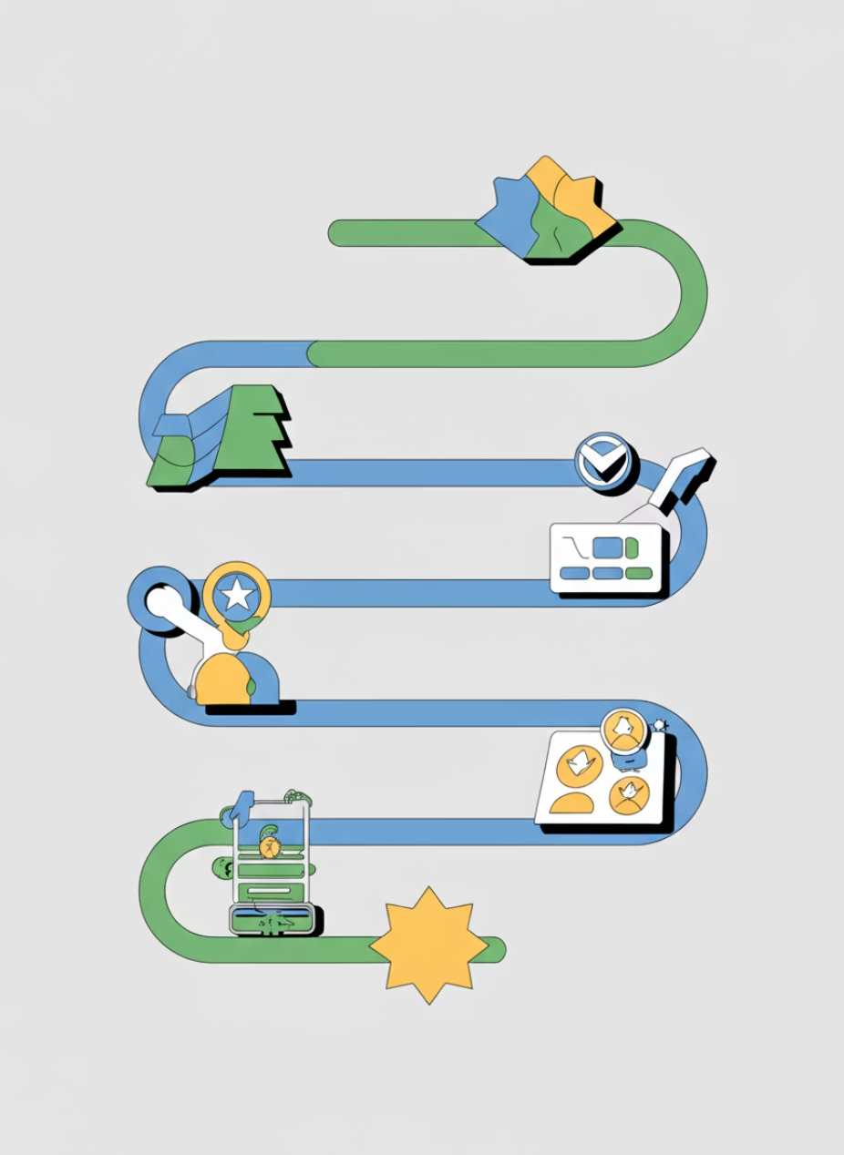
Process Dimension
Process is maturity translated into repeatable action
Reliability matters more than volume of controls
Structure reduces improvisation overhead
Good process protects decision flow
Clear documentation facilitates knowledge transfer
Feedback loops are essential for continuous improvement

Slide 32
PIVOT #3 – Process Reflection
Process turns intent into capability
Overcomplexity kills execution
Repeatability replaces individual heroics
Simplicity protects speed
Friction exposes weak design choices
Timing is part of design
Clarity enables consistent activation
Sequence matters more than detail
Resilience becomes predictable with structure
Maturity is felt in use
Learning from iteration fuels continuous improvement
Rigidity stifles innovation
Documentation facilitates knowledge transfer
Ambiguity leads to inconsistencies

Slide 33

Technology Dimension
Technology supports resilience but cannot replace culture
Tools amplify readiness only when aligned to purpose
Capability requires context, not platforms
Maturity is how technology enables continuity
Interoperability is crucial for a cohesive technological ecosystem
User adoption and training are essential for maximizing tool effectiveness

Slide 34
PIVOT #4 – Technology Reflection
Tools matter only when trusted
Maturity is adoption, not rollout
Capability must be usable at tempo
Tools follow governance context
Technology extends, not defines readiness
Systems inherit cultural strength
Enablement is stronger than automation
Alignment drives effectiveness
Technology must serve consequence
Integration proves relevance

Slide 35

Integration Dimension
Integration is maturity across all dimensions working as one
Domain alignment creates coherence under load
Capability becomes enterprise-level, not silo-level
Integration is the maturity threshold, not the start
Shared understanding fosters seamless collaboration
Interoperability ensures flexibility and scalability

Slide 36
PIVOT #5 – Integration Reflection
Integration makes capability durable
Fragmentation collapses trust
Alignment removes domain conflict
Unity stabilizes momentum
Posture becomes shared identity
Parity strengthens legitimacy
Maturity protects execution rhythm
Integration reduces friction
Readiness becomes intuitive
Coherence replaces resistance

Slide 37

What Real Maturity Looks Like
Teams move with shared understanding
Ownership is uncontested at activation
Confidence is visible before outcome
Escalation feels natural, not forced
Feedback loops are efficient and acted upon
Decisions are made swiftly with clear accountability

Slide 38

Where Organizations Get Stuck
They treat resilience as compliance, not capability
Maturity stalls when behavior is not reinforced
Documentation substitutes for readiness signals
Misalignment hides behind process comfort
Short-term gains are prioritized over long-term strategic growth
Decision-making is centralized, disempowering frontline teams

Slide 39

Signs of False Maturity
Heavy documentation without usable action
Dependency on heroics instead of structure
Clarity missing when pressure rises
Confidence collapses despite planning
Lack of adaptive strategies in dynamic environments
Success attributed to individuals rather than systemic robustness

Slide 40

How Maturity Accelerates Trust
Predictability lowers anxiety during uncertainty
Alignment creates psychological safety
Teams rely on structure, not improvisation
Trust becomes built-in instead of reactive
Consistent behavior fosters reliability
Open communication reduces assumptions

Slide 41

Maturity During Real Crisis
Stress tests convert belief into visible capability
Weak maturity collapses at tempo shift
Strong maturity stabilizes early orientation
Crisis reveals the cultural baseline
Established protocols enable rapid decision-making
Adaptability and resilience become critical strengths

Slide 42

Sustaining Maturity Over Time
Renewal prevents cultural erosion
Reinforcement protects alignment
Progress requires visible modeling
Continuity must live beyond compliance
Mentorship fosters growth and knowledge transfer
Feedback loops drive continuous improvement

Slide 43

SUMMARY & TAKEAWAYS
Maturity is proven capability, not documentation
Governance anchors confidence under stress
People dimension drives real readiness
Process enables repeatable execution
Technology supports, it does not lead
Integration is the maturity threshold
Trust reveals maturity before metrics

Slide 44
BREAK TIME
Be back in 15 mins.
Notes:
https://www.ncsc.gov.uk/static-assets/documents/PwnedPasswordsTop100k.txt

Slide 45
Lab Time
1 Hour
Notes:
https://www.ncsc.gov.uk/static-assets/documents/PwnedPasswordsTop100k.txt

Slide 46
BREAK TIME
Be back in 15 mins.
Notes:
https://www.ncsc.gov.uk/static-assets/documents/PwnedPasswordsTop100k.txt

Slide 47

Evolving Plans in Changing Environments
Keeping resilience aligned with living conditions
Understanding outdated plans in changing conditions
Developing adaptive planning mindsets for resilience
Transitioning to living guidance systems
Maintaining effectiveness during uncertainty

Slide 48
CLASS AGENDA
CLASS OBJECTIVES
Why plans become outdated
Signals that trigger evolution
Adaptive planning mindset
From static to living documents
Resilience in motion
See adaptation as a resilience function
Learn how change affects relevance
Shift from maintenance to evolution
Treat plans as living guidance
Build confidence during uncertainty

Slide 49
Why Plans Must Evolve
Conditions change faster than static documents: Businesses must constantly evolve to adapt to technology, competitors, and economic shifts.
Fixed plans collapse when assumptions expire: Many change initiatives fail without proper planning for adaptation.
Relevance matters more than completeness: Living plans adapting to current realities are more effective than outdated documentation.
Adaptation keeps capability real under stress: Effective change management builds adaptability and resilience to disruption.

Slide 50

When Plans Become Outdated
Assumptions drift: Underlying conditions change, invalidating planning assumptions.
Intensity changes: Market pressures outpace plan revision cycles.
Scale shifts: Growth or restructuring makes old planning logic unreliable.
Static guidance: Teams create workarounds when plans don't reflect reality.
New information emerges: Unexpected data render previous strategies obsolete.
Priorities shift: Business objectives or stakeholder needs evolve, changing goals.

Slide 51
PIVOT #1 – Awareness of Change
Evolution begins with awareness, not revision.
Monitoring prevents invisible erosion.
People must notice drift before correction.
Renewal protects continuity confidence.
Outdated plans appear stable until stressed.
Change recognition precedes adaptation.
Context shifts before documentation does.
Drift is a signal, not a surprise.
Awareness protects relevance early.
Awareness anchors forward movement.

Slide 52

Adapting Intent to Updated Reality
Plans evolve when purpose stays stable but methods shift.
Adaptation preserves intent; mechanics update.
Relevance measures maturity, not original design.
Renewal maintains legitimacy through effective change management.

Slide 53
PIVOT #2 – Adaptation Reflection
Adaptation sustains trust in guidance
Plans must reflect current truth
Intent must outlast mechanism
Alignment requires lived relevance
Renewal keeps direction credible
Adaptation signals organizational health
Flexibility protects readiness window
Drift becomes failure when ignored
Renewal is governance in motion
Change is maintenance of accuracy

Slide 54

Updating Behavior, Not Just Documents
Real change appears in conduct before documentation: Employees learn new features/procedures through training.
Behavior must update faster than written plans: Operational adjustments precede formal documentation.
Execution becomes the proof of relevance: Actual work reveals plan relevance and usefulness.
Practice validates resilience alignment: Behavioral changes demonstrate true support for organizational resilience goals.

Slide 55
PIVOT #3 – Execution Adaptation
Behavior reveals whether change took root
Adoption precedes endorsement
Execution reflects belief, not direction
Renewal becomes visible through action
Adaptation shows up in tempo
Policy follows what already works
Culture carries change forward
Practice exposes outdated posture
Use validates improvement
Maturity is lived, not claimed

Slide 56

How Resilience Stays Alive in Motion
Resilience evolves: Change management enables organizations to adapt quickly without sacrificing performance or user experience.
Renewal maintains trust: Continuous adaptation keeps organizational direction reliable during turbulent periods.
Flexibility ensures continuity: Effective change management reduces disruptions and maintains productivity.
Adaptation makes resilience durable: Strategic change management transforms uncertainty into opportunity.

Slide 57

SUMMARY & TAKEAWAYS
Plans expire when context shifts faster than revision.
Awareness is the start of adaptation.
Relevance matters more than preservation.
Renewal sustains trust in guidance.
Behavior evolves before documentation.
Adaptation protects continuity credibility.
Resilience is a living capability.

Slide 58
BREAK TIME
Be back in 15 mins.
Notes:
https://www.ncsc.gov.uk/static-assets/documents/PwnedPasswordsTop100k.txt

Slide 59


Developing Organizational Resilience Culture
Culture is resilience lived before plans are referenced
Trust drives adaptability faster than compliance
Behavior models readiness under pressure
Leadership tone becomes psychological infrastructure
Resilience becomes instinct when normalized
Governance Anchor: "Culture is how resilience behaves when no one is enforcing it."

Slide 60
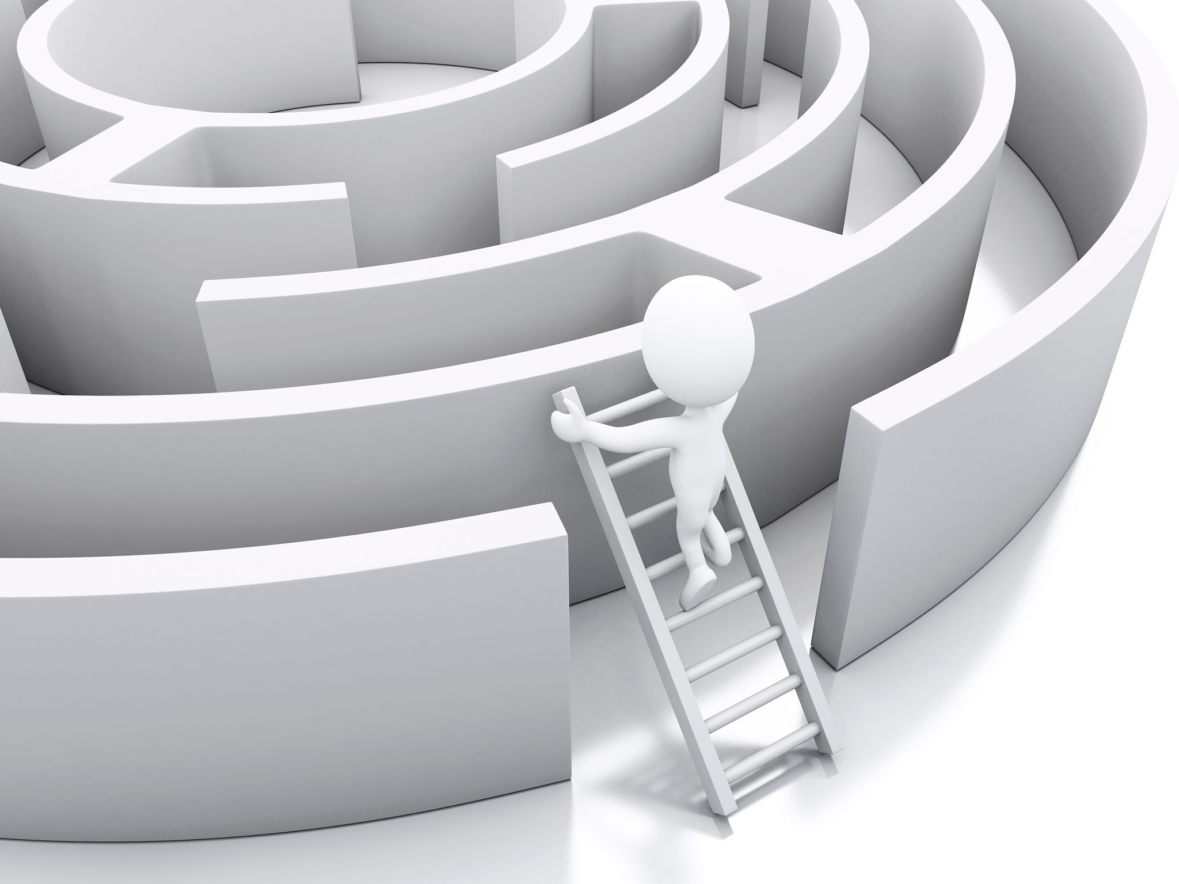
Lab: Maturity Assessment
Assessment reveals capability gaps, not paperwork gaps
Case studies surface resilience behavior under load
Alignment is evaluated through lived practice
Evidence must show execution, not intention
Culture and governance determine maturity posture
Governance Anchor: "Assessment validates whether resilience is identity or performance."

Slide 61
Evolving Plans in Changing Environments
Static plans expire as conditions shift
Adaptation preserves legitimacy and trust
Behavior must evolve before documentation does
Relevance matters more than preservation
Renewal is governance in motion
Governance Anchor: "Resilience stays credible when plans evolve at the speed of reality."

Slide 62
Cultural Reinforcement & Sustainment
Continuity depends on reinforcement, not reminders
Identity sustains capability through leadership changes
Peer norms carry resilience beyond formal structure
Trust accelerates alignment during pressure
Culture is the maturity container
Governance Anchor: "When resilience becomes identity, maturity becomes self-sustaining."

Slide 63
Kahootz & Quiz Time
Notes:
https://www.ncsc.gov.uk/static-assets/documents/PwnedPasswordsTop100k.txt

